Slide 1
United Way of Greater Nashville
Annual [COMPANY NAME] Campaign Kickoff

Slide 2
Agenda
About United Way of Greater Nashville
Brian Hassett, UWGN president and CEO
[WORKPLACE ECM, CEO]
Campaign Video
Incentives
Goal
Activities
Closing

Slide 4
What We Do
We bring individuals, businesses, government decision makers and nonprofit agencies together to identify our community’s most pressing needs and make smart investments that will break the cycle of poverty and ensure every individual and every family in our community thrives.

Slide 6
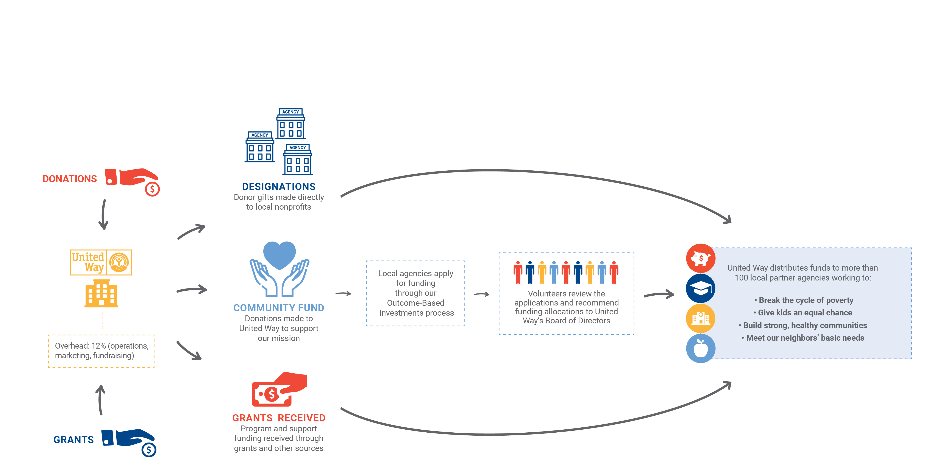
How We Work

Slide 8
Impact Areas

Slide 13
Importance of Your Support
Brian Hassett,
United Way of Greater Nashville
President and CEO
[WORKPLACE ECM, CEO]

Slide 14
Campaign Video
[INSERT FULL-SCREEN CAMPAIGN VIDEO]

Slide 15
[INSERT THEME]
GOAL: [INSERT GOAL]

Slide 16
INCENTIVES:
[INCENTIVE 1]
[INCENTIVE 2]
[INCENTIVE 3]

Slide 17
Campaign Schedule
[DAY]
[Activity]
[Details]
[DAY]
[Activity]
[Details]
[DAY]
[Activity]
[Details]
[DAY]
[Activity]
[Details]
[DAY]
[Activity]
[Details]

