Slide 1
Annual [COMPANY NAME] Campaign Kickoff

Slide 2
Agenda
About United Way of Greater Nashville
Brian Hassett, UWGN president and CEO
[WORKPLACE ECM, CEO]
Campaign Video
Incentives
Goal
Activities
Closing

Slide 3
About United Way
of Greater Nashville
Mission We unite the community and mobilize resources so that every child, individual and family thrives.
Vision We envision a community where every person–no matter their background, their circumstances or their zip code–has an equal chance at a bright future.

Slide 4
What We Do
We bring individuals, businesses, government decision makers and nonprofit agencies together to identify our community’s most pressing needs and make smart investments that will break the cycle of poverty and ensure every individual and every family in our community thrives.

Slide 5
We Believe
If we work together, we can ensure that …
no one in our community lives in poverty,
everyone has a home and food to eat,
every person has access to quality health care and a supportive neighborhood and
every child has the tools and resources they need to succeed in school and beyond.

Slide 6
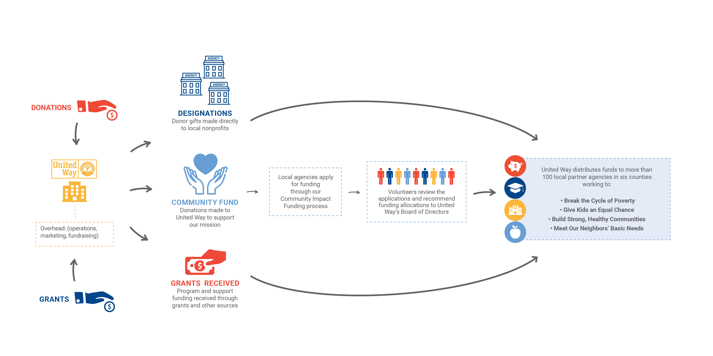
How We Work

Slide 7
Why United Way?
We bring the community together, in a way no single organization can, to have the tough conversations, mobilize the resources and develop the collective solutions necessary to attack poverty at its roots.

Slide 8
Impact Areas

Slide 13
What a Dollar Buys
$52 brings a person experiencing homelessness in off the street for a night
$104 provides a senior with transportation for two months to pick up medications and groceries
$250 helps a teen transitioning out of foster care get set up in their first college dorm room
$500 provides training to help someone find a better job so they can support
themselves financially
$1,000 helps three seniors update their homes to
accommodate a wheelchair

Slide 14
Importance of Your Support
Brian Hassett,
United Way of Greater Nashville
President and CEO
[WORKPLACE ECM, CEO]

Slide 15
Campaign Video
[INSERT FULL-SCREEN CAMPAIGN VIDEO]

Slide 16
[INSERT THEME]
GOAL: [INSERT GOAL]

Slide 17
INCENTIVES:
[INCENTIVE 1]
[INCENTIVE 2]
[INCENTIVE 3]

Slide 18
Campaign Schedule
[DAY]
[Activity]
[Details]
[DAY]
[Activity]
[Details]
[DAY]
[Activity]
[Details]
[DAY]
[Activity]
[Details]
[DAY]
[Activity]
[Details]

Slide 19
Give now. Give generously.
unitedwaygreaternashville.org

