Slide 1
Annual [COMPANY NAME] Campaign Kickoff

Slide 2
Agenda
About United Way of Greater Nashville
Brian Hassett, UWGN president and CEO
[WORKPLACE ECM, CEO]
Campaign Video
Incentives
Goal
Activities
Closing

Slide 3
About United Way
of Greater Nashville
Mission We unite the community and mobilize resources so that every child, individual and family thrives.
Vision We envision a community where every person–no matter their background, their circumstances or their zip code–has an equal chance at a bright future.

Slide 4
What We Do
We bring individuals, businesses, government decision makers and nonprofit agencies together to identify our community’s most pressing needs and make smart investments that will break the cycle of poverty and ensure every individual and every family in our community thrives.

Slide 5
We imagine a future where …
Families are healthy and strong.
All kids learn and succeed.
No one lives in poverty.
Everyone’s basic needs are met.

Slide 6
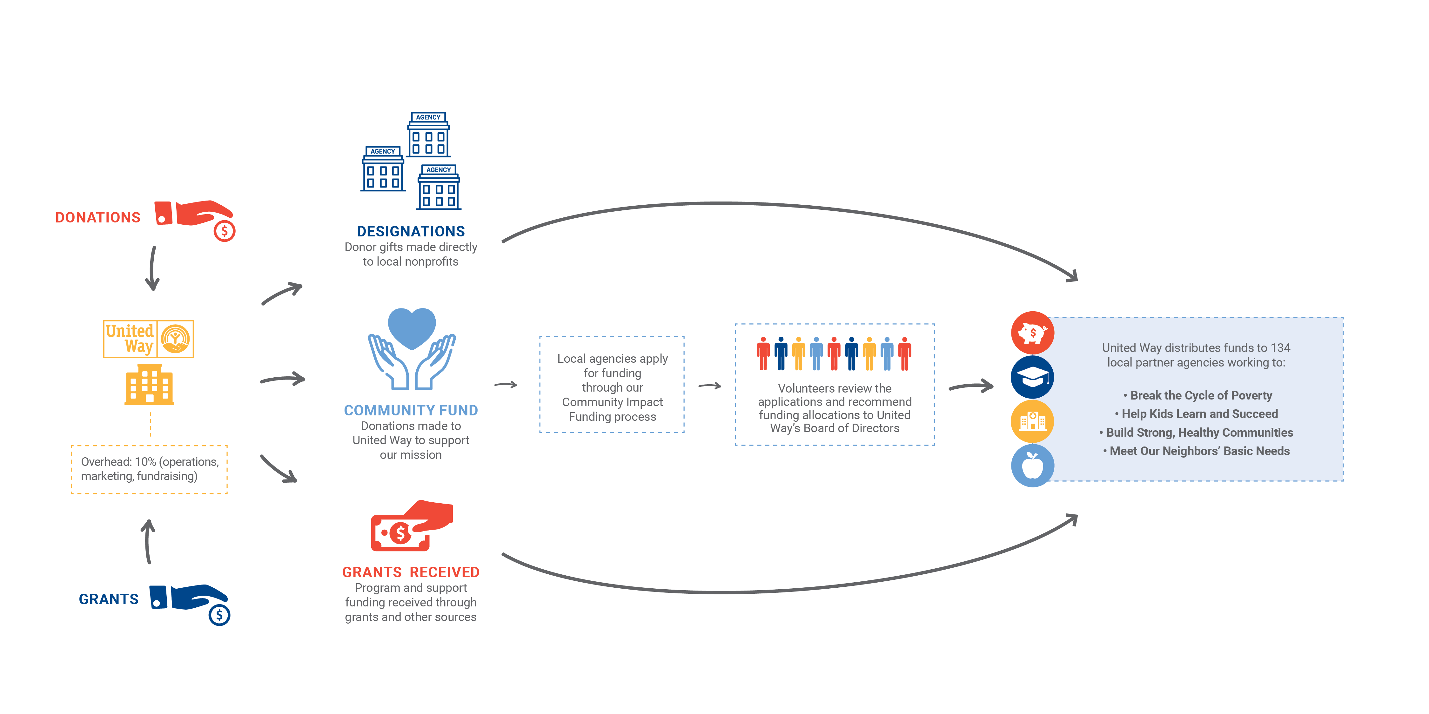
How We Work

Slide 7
Why United Way?
We bring the community together, in a way no single organization can, to have the tough conversations, mobilize the resources and develop the collective solutions necessary to attack poverty at its roots.

Slide 8
Impact Areas

Slide 17
What a Dollar Buys
$2 per pay period = eight meals for a family of four
$4 per pay period = books for 80 preschoolers
$10 per pay period = educational summer camp for 12 kids in need
$20 per pay period = job training for four people so they can support themselves financially
$40 per pay period = counseling for five victims of abuse
*Based on 26 pay periods per year

Slide 18
Importance of Your Support
Brian Hassett,
United Way of Greater Nashville
President and CEO
[WORKPLACE ECM, CEO]

Slide 19
Campaign Video
[INSERT FULL-SCREEN CAMPAIGN VIDEO]

Slide 20
[INSERT THEME]
GOAL: [INSERT GOAL]

Slide 21
INCENTIVES:
[INCENTIVE 1]
[INCENTIVE 2]
[INCENTIVE 3]

Slide 22
Campaign Schedule
[DAY]
[Activity]
[Details]
[DAY]
[Activity]
[Details]
[DAY]
[Activity]
[Details]
[DAY]
[Activity]
[Details]
[DAY]
[Activity]
[Details]

Slide 23
Give now. Give generously.
unitedwaygreaternashville.org
With your help, we can ensure every person has an equal chance at a bright future.

